Slide 1
Autonomous AI-Training for Robot-Assisted Sorting for Efficient Recycling (automation/cloud)
By Lyon Kee

Slide 2
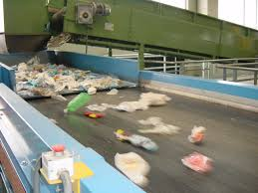
overview
Sorting framework that operates on the cloud and utilizes generative AI
Capitalize on firsthand information on consumer behavior
Collect accurate unbiased data of items
Notes:
We are attempting to create a sorting framework that operates on the cloud which utilizes generative AI. We are attempting to create a model that is able to identify recycling materials from milk jugs, to bottles, to cans, and we are wishing to expand it to the ability to identify products. When a company for example coca cola pays us to track their cans, we would be able to make a prediction on the number of coca cola cans that goes through a recycling plant. We would then have an Articulate robot arm that would be able to sort the items respectively into their categories.
Why do we do this? When we look at the ways in which information about consumer behavior is collected so far, we see that these methods are often slow and would not reflect the current change in consumer behavior, such as tracking how many coca cola is being sold in every state and so on. However, when we look at recycling plants, we are able to obtain close to realtime information on how much a certain product is being consumed. These information will then be able to tell companies the change in trend and make amends to reduce production or increase production.
But why use an AI model? Why not just use man power? This is because the recycling field is often less paying and are labor intensive where items come in throughout the day and night. When we use a model, we are able to keep object detection running 24/7. When we look at data collection, humans are often biased and such labor intensive jobs are prone to lots of human mistakes. With a model, we are able to collect accurate unbiased data of items that goes into a recycling plant, and this model can then be used in other recycling plant without the need to train human workers.

Slide 3
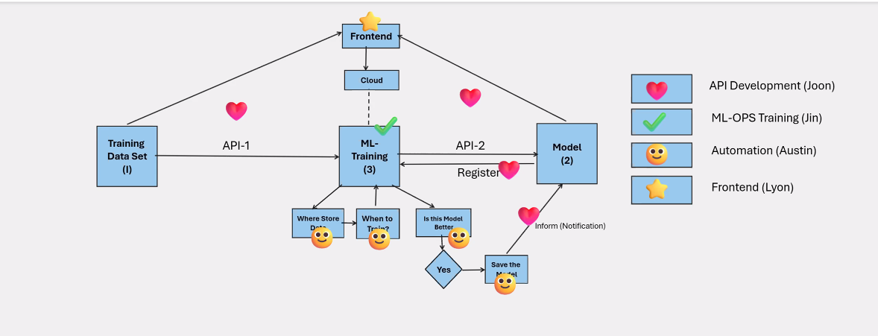
automation
Notes:
This is a rough diagram of what the automation team is attempting to create. We have not been told any time estimates on what is to be expected of us but just the idea of things.

Slide 4
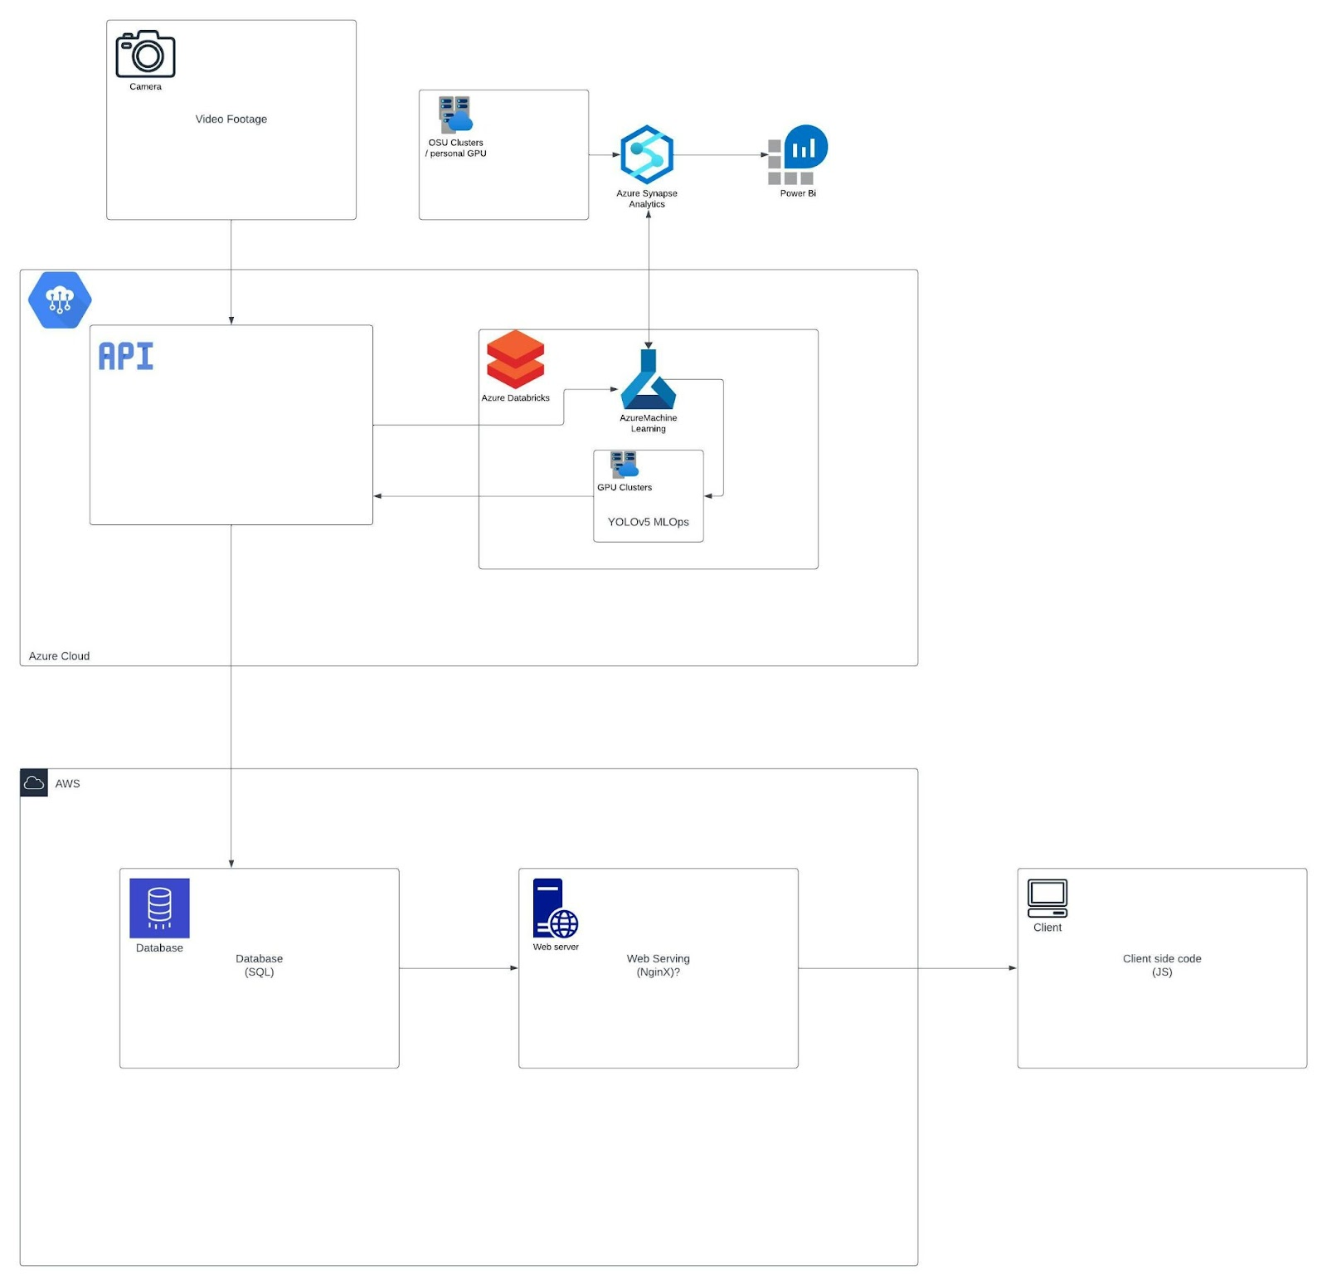
Notes:
Rough diagram of how everything is tied together

Slide 5
deliverables
Obtain ML tools
Make APIs for data input, training, and output
Configure Azure MLOps
Train on YOLOv5/YOLOv8
Ability to retrain models without starting from scratch
3-D model objects to be used as training data
Notes:
3D models of object to create training data

Slide 6
maintenance
There will be a feedback form on the frontend to file issues
Project partner has another team that is working on the project

Slide 7
interface
Ability to input data
Data analytics/visualization tools

Slide 8
Project management/tooling
Weekly meeting
GitHub
Azure cloud
Firebase
React
Notes:
Weekly meeting – project partner provides us with things to read up on and tasks while we update him on the things we’ve been doing

Slide 9
Questions?

